Slide 1
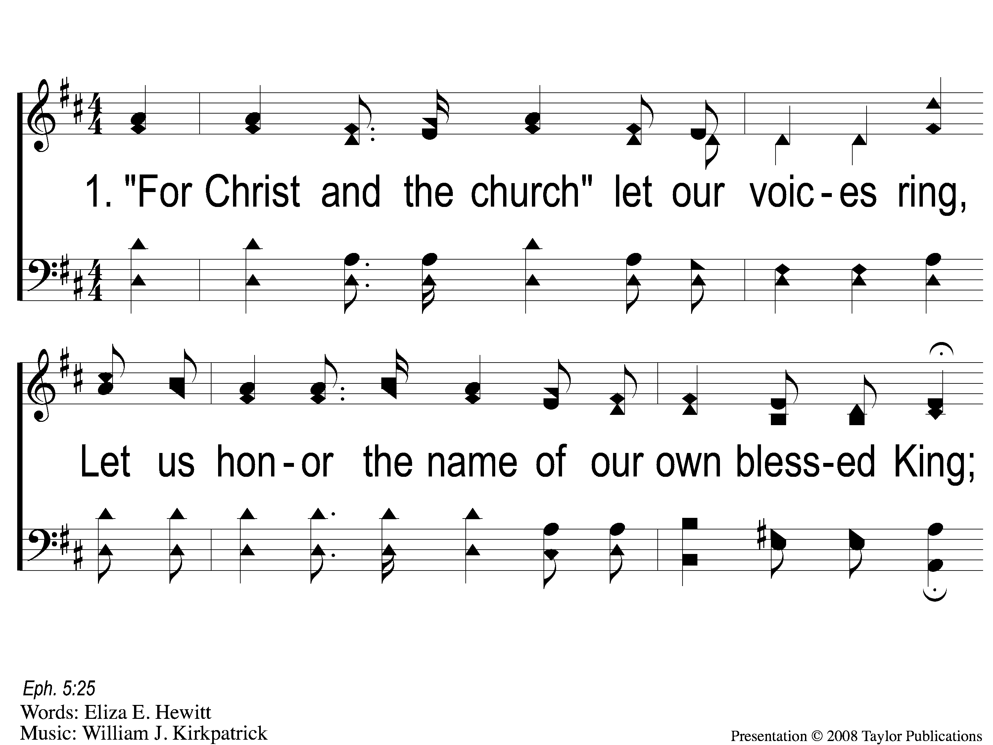
1-1 For Christ and the Church
For Christ and the Church
121

Slide 2
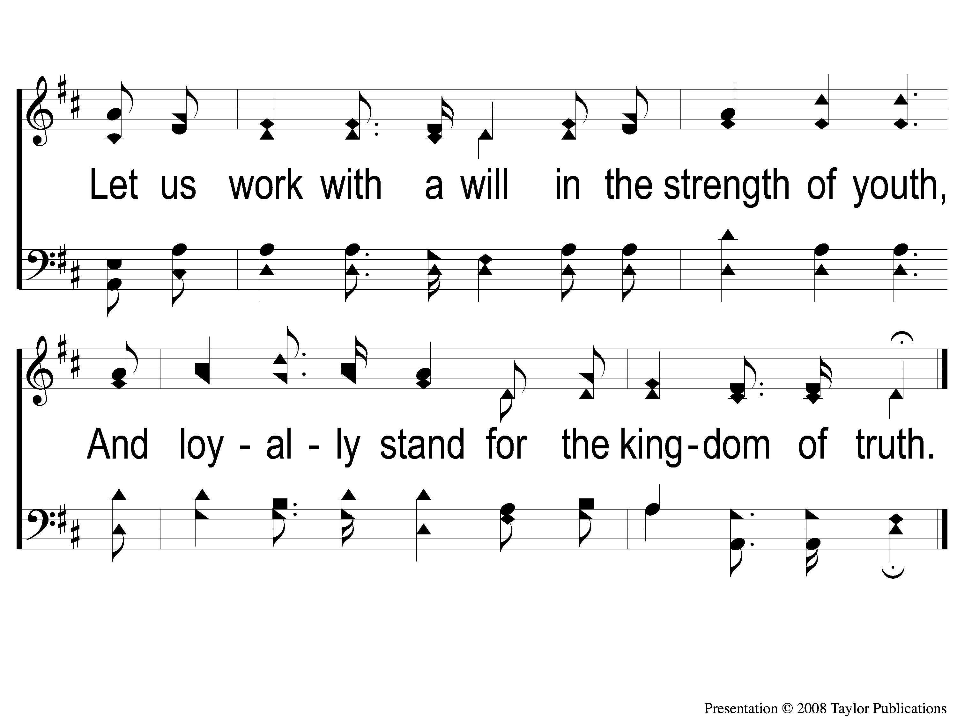
1-2 For Christ and the Church
For Christ and the Church
121

Slide 3
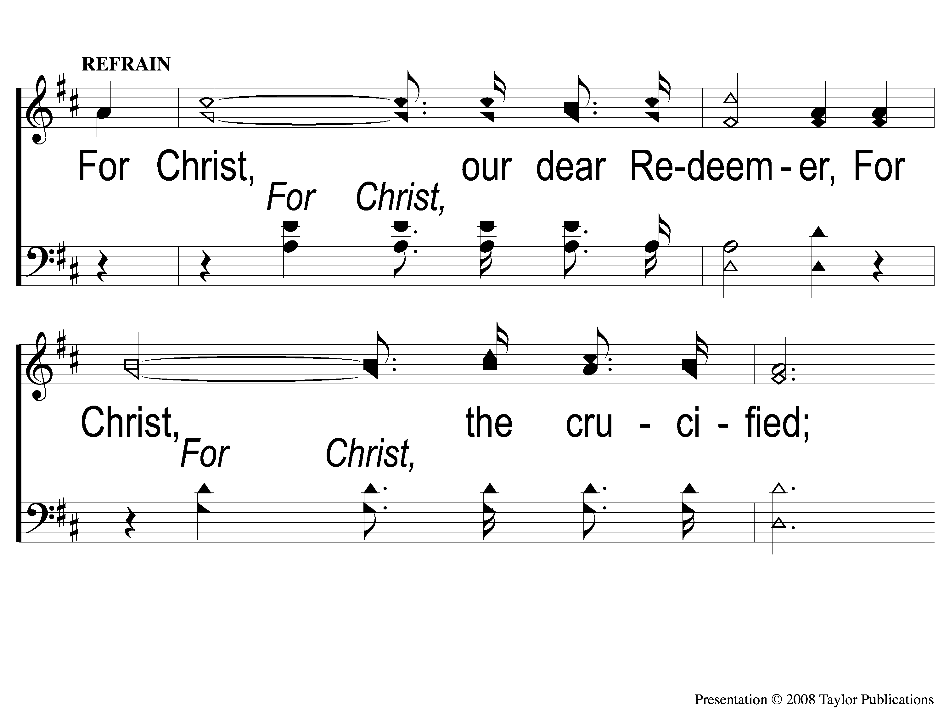
C-1 For Christ and the Church
For Christ and the Church
121

Slide 4
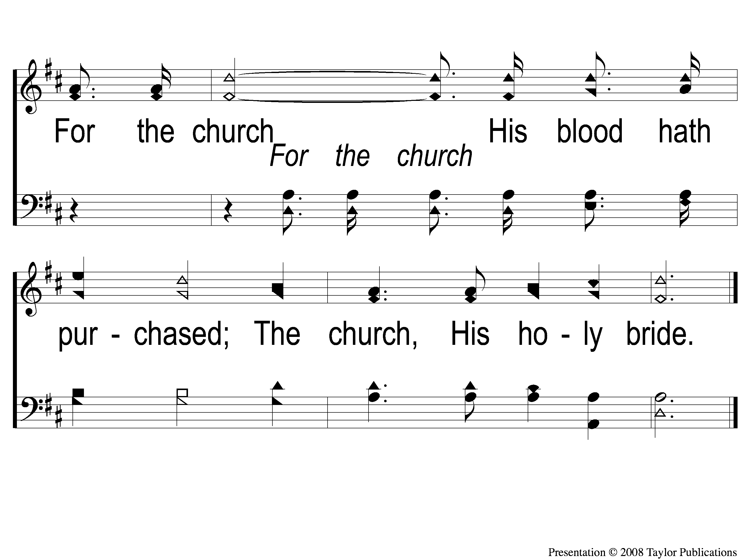
C-2 For Christ and the Church
For Christ and the Church
121

Slide 5
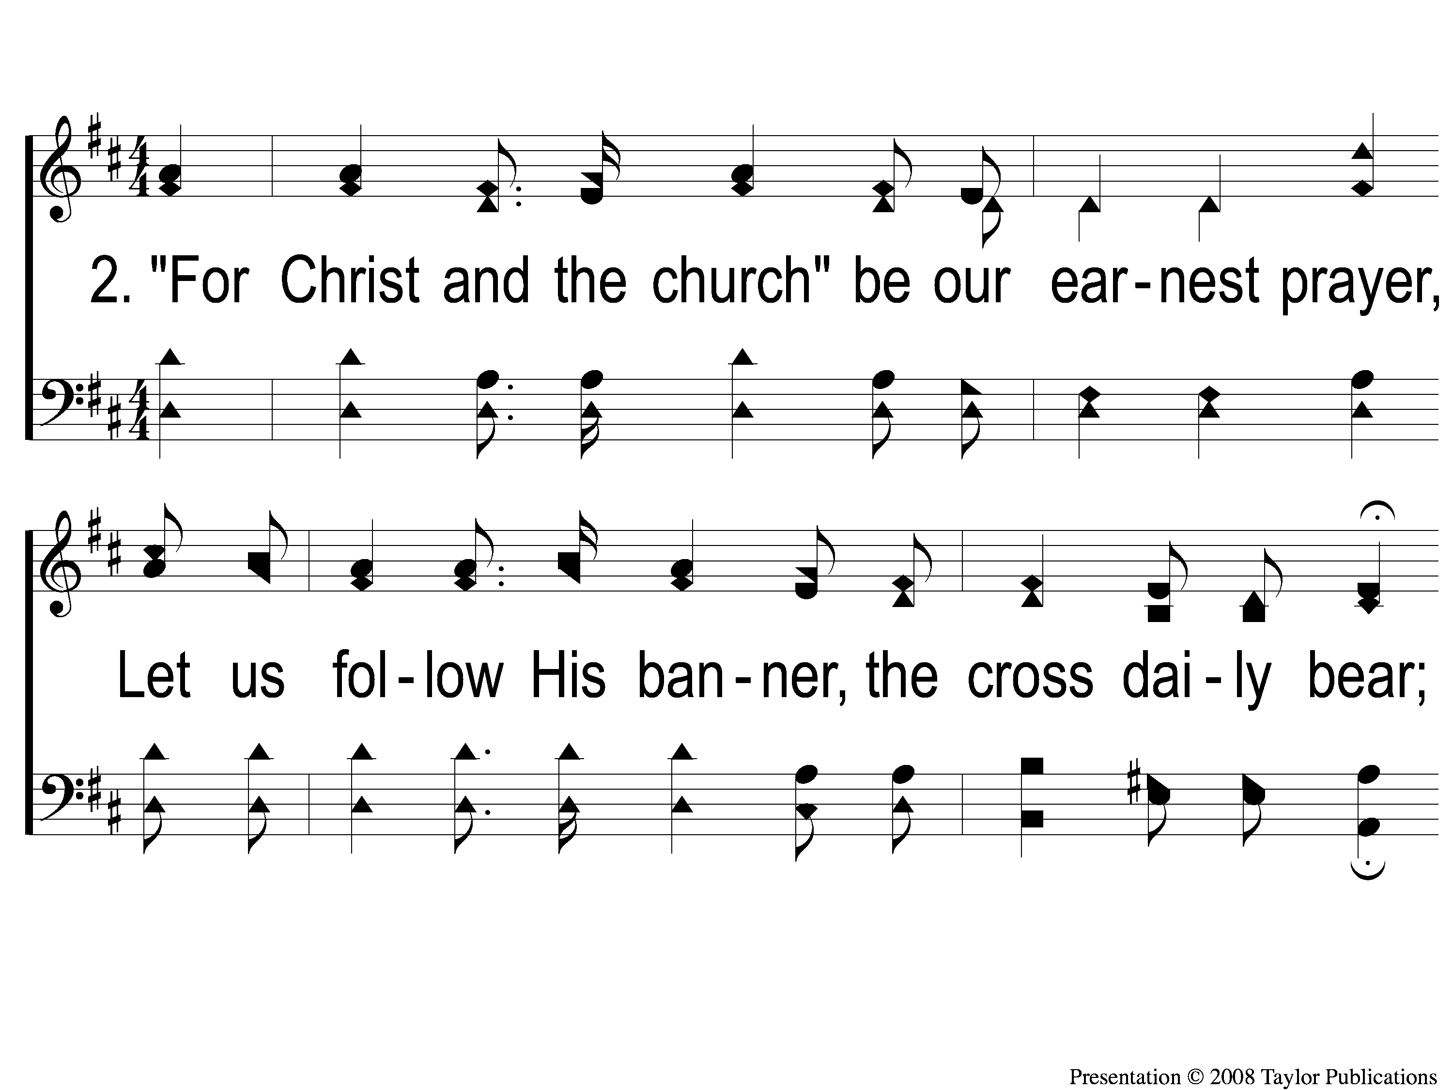
2-1 For Christ and the Church
For Christ and the Church
121

Slide 6
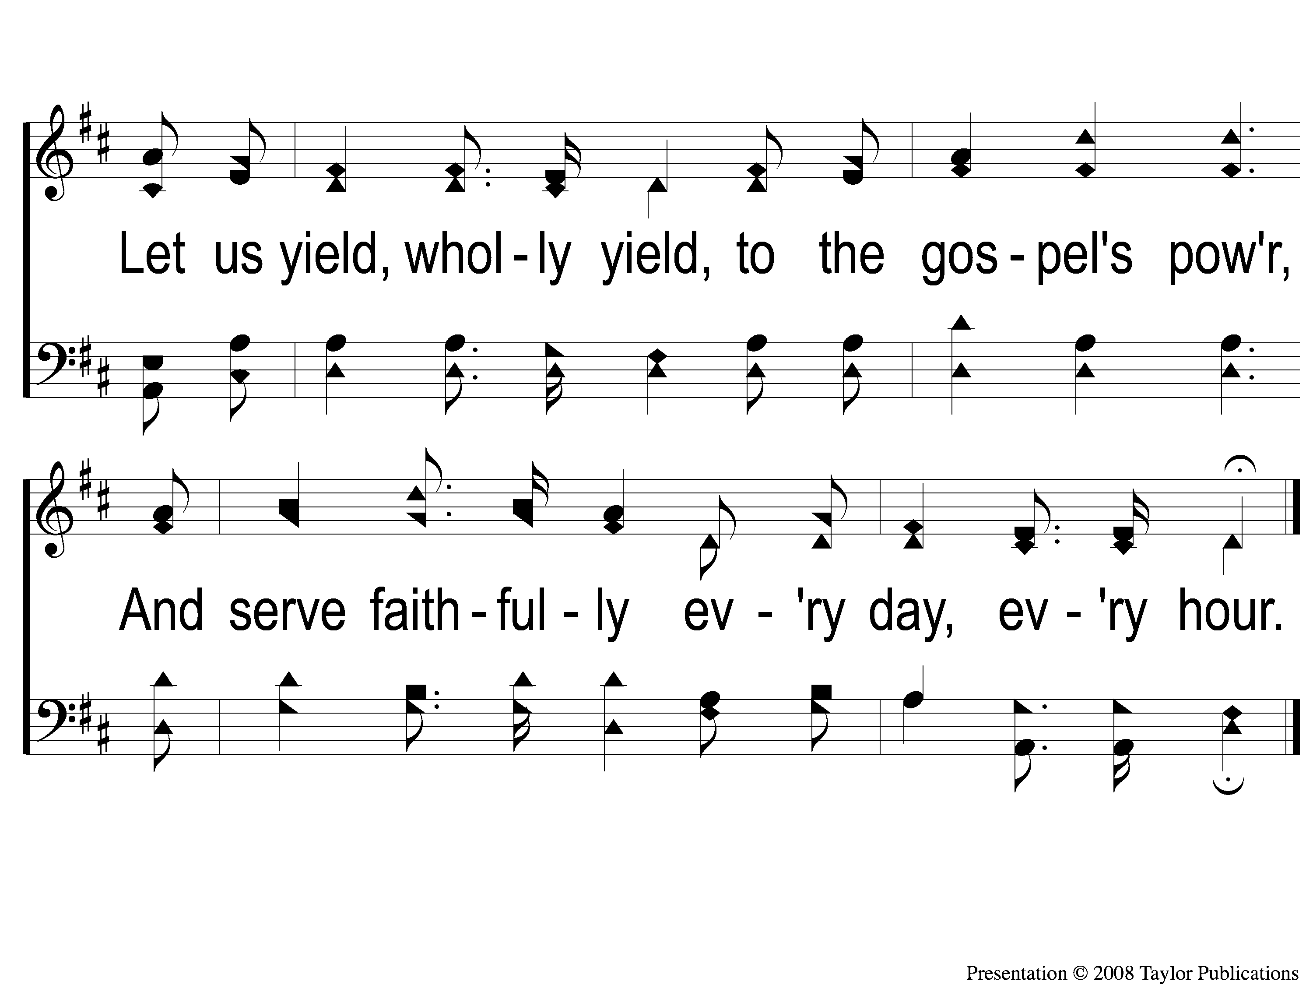
2-2 For Christ and the Church
For Christ and the Church
121

Slide 7
C-1 For Christ and the Church
For Christ and the Church
121

Slide 8
C-2 For Christ and the Church
For Christ and the Church
121

Slide 9
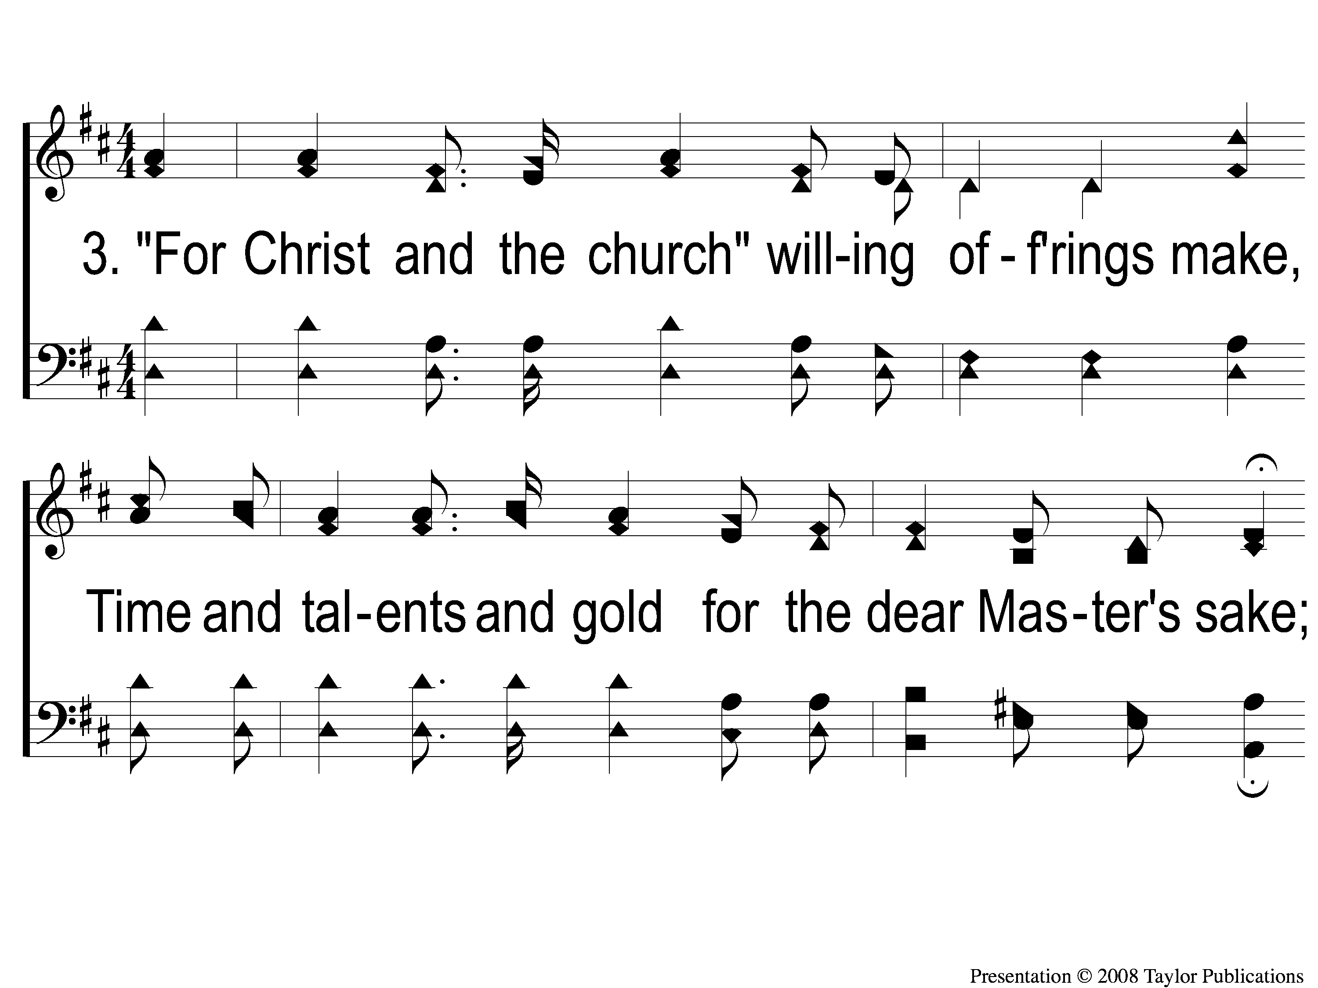
3-1 For Christ and the Church
For Christ and the Church
121

Slide 10
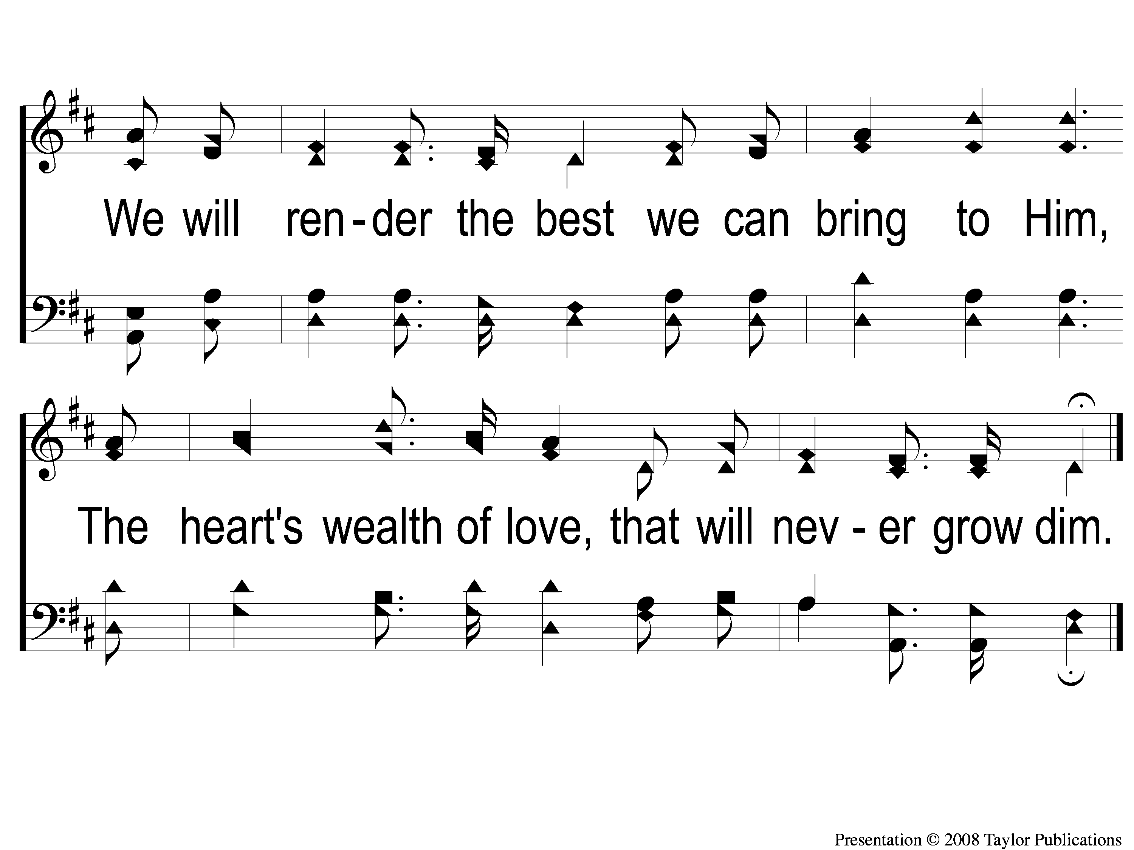
3-2 For Christ and the Church
For Christ and the Church
121

Slide 11
C-1 For Christ and the Church
For Christ and the Church
121

Slide 12
C-2 For Christ and the Church
For Christ and the Church
121

Slide 13
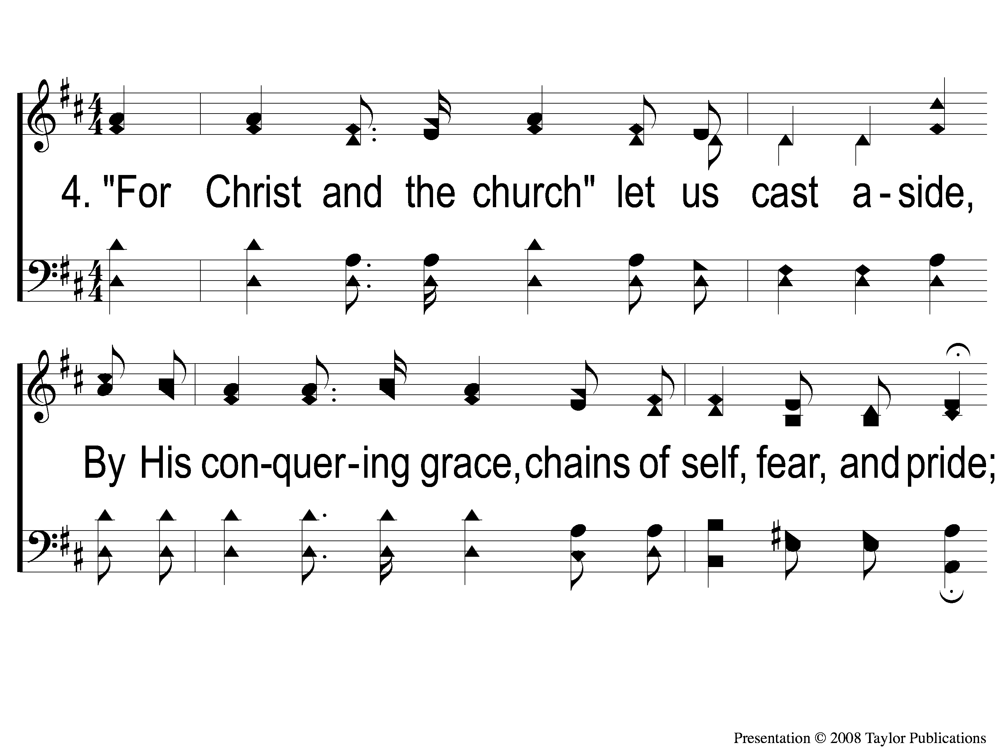
4-1 For Christ and the Church
For Christ and the Church
121

Slide 14
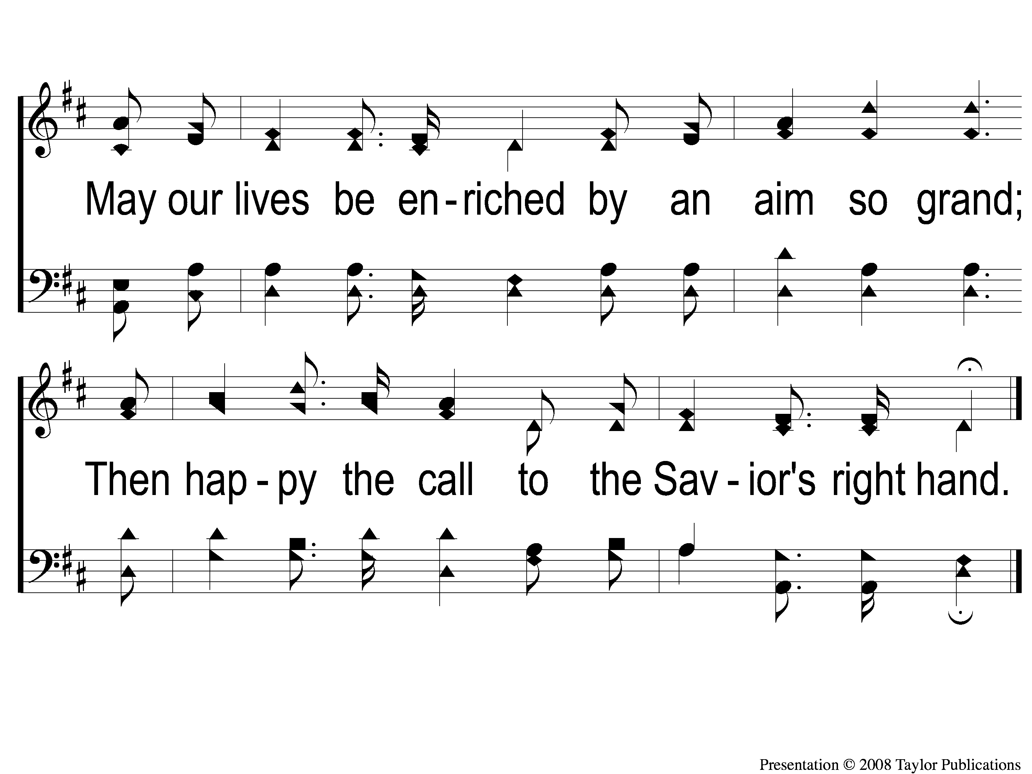
4-2 For Christ and the Church
For Christ and the Church
121

Slide 15
C-1 For Christ and the Church
For Christ and the Church
121

Slide 16
C-2 For Christ and the Church
For Christ and the Church
121

